Slide 1
Troy Hutchison
Skype Connected to a SIP PBX

Slide 2
What is Skype?
Voice over IP
Peer to Peer
Seamless across NAT and Firewalled Systems
Super Nodes
Proprietary Protocol
Voice Quality

Slide 3
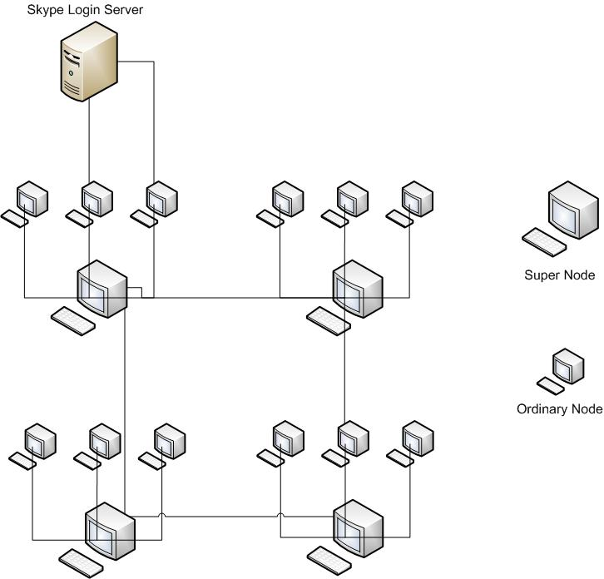
Skype Topology

Slide 4
What is a SIP PBX
Session Initiation Protocol (SIP)
Components
SIP User Agents (UAs)
SIP Registrar and Location Servers
SIP Proxy Servers
SIP Redirect Servers

Slide 5
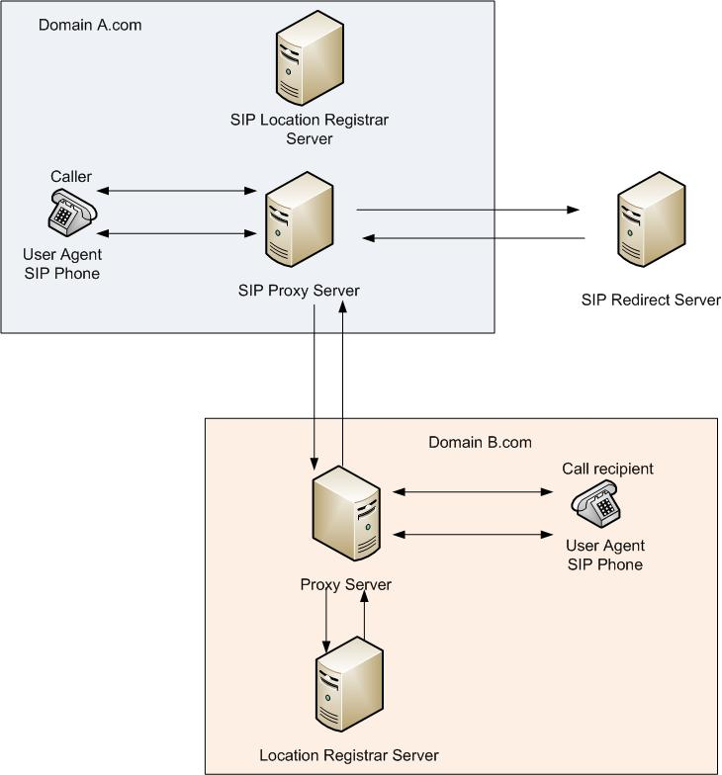
SIP Topology

Slide 6
Making the connection
SIP PBX Must be SKYPE Certified
Account in Skype Business Control Panel
Internet connection capable of handling the additional bandwidth
Use a specialized SIP QoS-based router
A prepayment method
Traditional fixed telephone line

Slide 7
Conclusion
The benefits of making the connection between Skype and a SIP based PBX system;
Skype phone rates on international call
Local Skype international numbers
The ability for Skype users to call the Business by clicking on an icon
Risks of making the connection between Skype and SIP based PBX System;
The SIP PBX must use a public addressable IP
Skype for SIP calls are not encrypted

Slide 8
Questions

